Slide 1


CS 251
Project 1 - DNA
UTAs:
Leeza Andryushchenko
Raka Primardika

Slide 2
Extra Credit Deadline
Wednesday, September 1st for 10% extra credit (extra 10% applies to your grade, not the maximum total).
Must pass 100% of test cases
Sunday, September 5th for regular deadline.
5 late days available throughout semester
Not 5 for each project

Slide 3
Suggested Timeline
Wed, 25/8
Thu, 26/8
Fri, 27/8
Sat, 28/8
Sun, 29/8
Mon, 30/8
Tue, 31/8
Wed, 01/9
Jumpstart
Read Project PDF
Start M0
Plan M1
Start M1
Finish M1
Finish M2
Start M3
Finish M3
Plan M4
Start M4
Finish M4
Finish M5
Start M6
Finish M6
Write ourvector analysis
Review code for style points
Submit for EC
Grad TA OH
10.30-noon
1-2.30pm
4.30-6pm
Grad TA OH
12-1.30pm
Campus Help Sessions
3-6pm
Campus Help Sessions
3-6pm
Grad TA OH
11.30-1pm
2-3.30pm
Grad TA OH
12-1.30pm
Campus Help Sessions
3-6pm
Online Help Sessions
7-11pm
Online Help Sessions
7-11pm
Online Help Sessions
7-11pm
Online Help Sessions
7-11pm
Campus Help Sessions
3-6pm
Campus Help Sessions
3-6pm
Campus Help Sessions
3-6pm

Slide 4

Difficulty Rating
Milestone #0 → Design Your App
1/5
Get started with your Project, Review sections and milestones.
Set up your Mimir account if you haven’t done that already
Read through the whole project pdf before starting !! Make sure you pay attention to style and functionality requirements
Plan what you want to do → what parts of the project seem hard, and what milestones are easy for you to finish?
Start coding the menu. (cout, cin, loops, etc.)

Slide 5
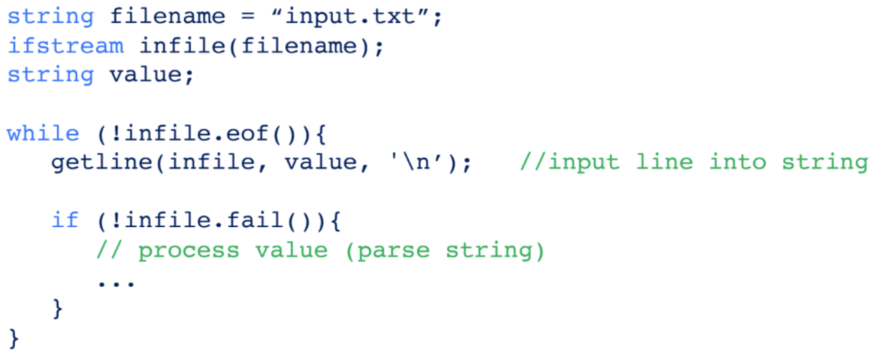
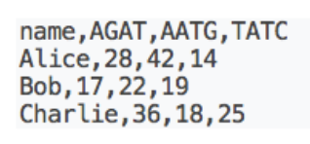
Milestone #1 → Load Data, Database
Difficulty Rating
5/5
Implement the load_db command
Plan First! What type of container is best to use?
Involves file reading and string parsing. (small.txt or large.txt)
See: “Learning C++ and more about ourvector” at the bottom of the project page
There, you can find syntax and hints for file streams and string streams
You cannot store any DNA in strings, only ourvectors.
“AGAT”, “GGGTTTTA” (don’t put “AGAT” as a single element)
{‘A’, ‘G’, ‘A’, ‘T’}, {‘G’, ‘G’, ‘G’, ‘T’, ‘T’, ‘T’, ‘T’, ‘A’}

Slide 6
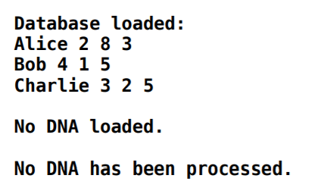
Milestone #2 → Display Data
Difficulty Rating
2/5
display command implementation
Main objective → output information about DNA samples in the system on the screen in a specific format (see picture and project pdf)
This milestone is a good extra testing tool for milestone #1! Make sure previous milestone functions correctly, otherwise output will not match the information on the loaded file
SAMPLE OUTPUT FOR SMALL.TXT TEXT FILE

Slide 7
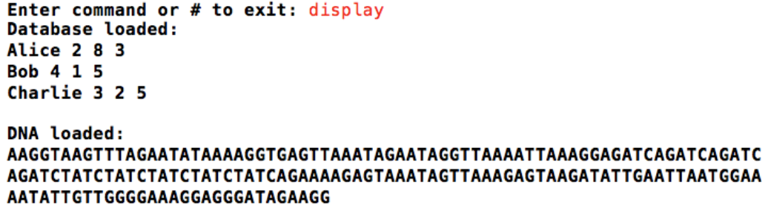
Milestone #3 → Load Data, DNA
Difficulty Rating
2/5
Implement the load_dna command
Involves file reading again. (1.txt through 20.txt)
Read a line from a file containing a full DNA sequence and storing it into a container in your program.
Similar restrictions to Milestone #1
Update the display command from Milestone #2 to now also display the DNA sequence you just loaded.
Test by submitting the project. Should pass all test cases with load_db, load_dna, display.

Slide 8
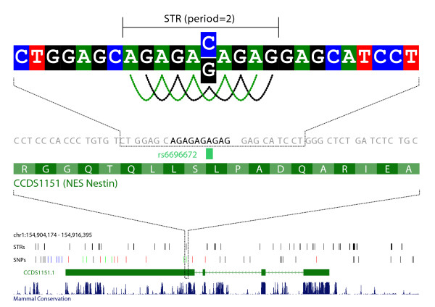
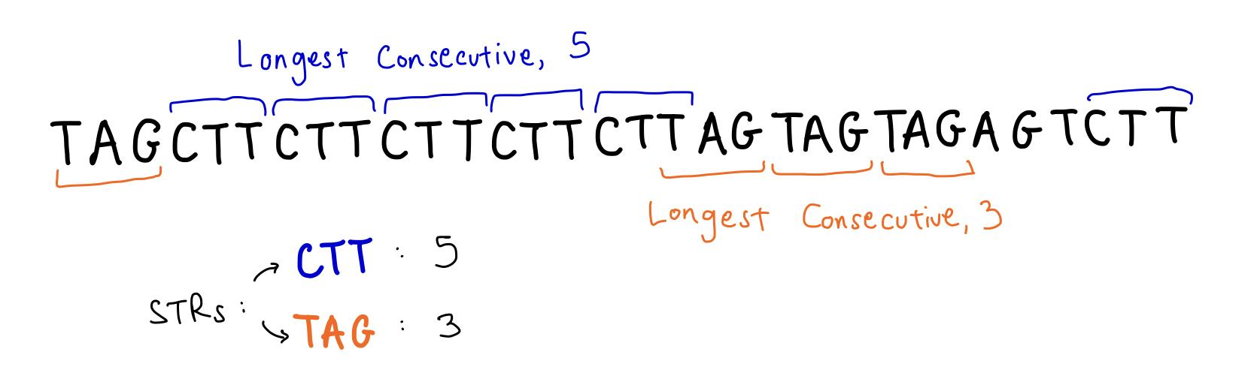
Milestone #4 → Processing DNA
Difficulty Rating
5/5
Process command implementation
After receiving a DNA, you have to count the longest consecutive appearance of each STR in the sequence, how to do that is for you to figure out! Come up with an algorithm you understand and can implement, as this milestone is the heart of this project

Slide 9
Milestone #4 → Processing DNA (continuing)
There are some edge cases in this milestone you have to think about. For instances where the system is empty or no DNA was loaded before calling process command you have to output error messages on the terminal
No database loaded. → when there is no information in the database
No DNA loaded. → when no DNA was loaded before calling the process function

Slide 10
Milestone #5 → Searching
Difficulty Rating
3/5
Make sure Milestone #4 works properly.
Once you have the number of STR occurrences, you want to search through the database for a person who has the same number.
It is possible to have no matches.
Consider error/edge cases, and the messages:
Database not loaded → No database loaded
DNA not loaded → No DNA loaded
Both not loaded → No DNA processed
Match not found → Not found in database

Slide 11
Milestone #6 → Creative Component
Difficulty Rating
?/5
Add your own command
Ideas:
Command to test multiple functions of the program
Command to count all STR occurrences, not just the longest one
Command to identify multiple DNA files at once
Think of something on your own.
Add comment at the top of your code to show how to use your command
Don’t make a command that just outputs this.
Never gonna give you up
Never gonna let you down
Never gonna run around and desert you

Slide 12
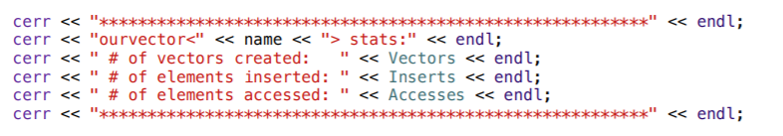
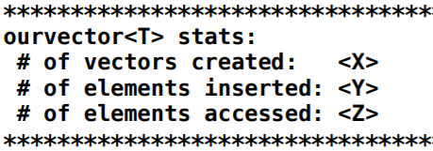
Ourvector Analysis
After you are done with the project AND your code passes all tests, it is time to work on your ourvector analysis! In ourvector class source code you will find the following piece of code (Line 504)
Uncomment it! This function will provide you with memory use statistics of your code. The main goal of this part of the project is for you to “justify” or simply explain every number in that statistics

Slide 13
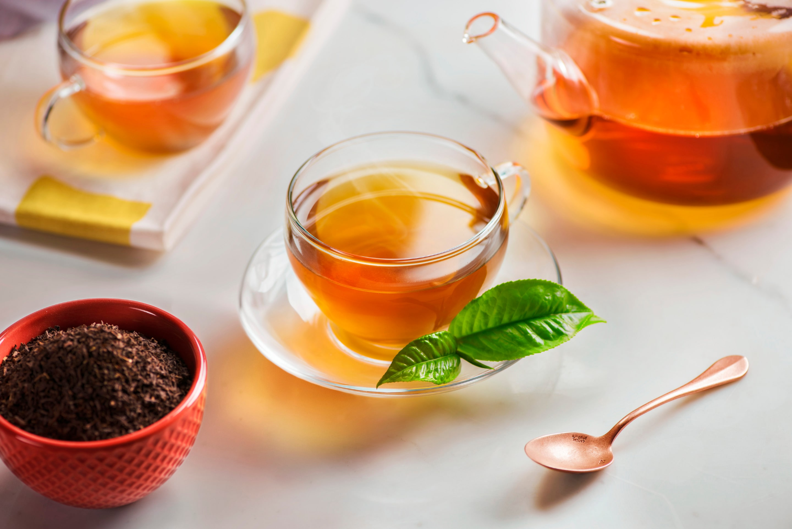
Ourvector Analysis
To receive a full statistics report, make sure you run each command once (ONLY once).
In 250 words or less, go over each of the 3 numbers you receive and explain them. You will have to refer to your code again to see where vectors are created and how many elements were inserted (this may take time so make some tea!)

Slide 14
Suggested Timeline
Wed, 25/8
Thu, 26/8
Fri, 27/8
Sat, 28/8
Sun, 29/8
Mon, 30/8
Tue, 31/8
Wed, 01/9
Jumpstart
Read Project PDF
Start M0
Plan M1
Start M1
Finish M1
Finish M2
Start M3
Finish M3
Plan M4
Start M4
Finish M4
Finish M5
Start M6
Finish M6
Write ourvector analysis
Review code for style points
Submit for EC
Grad TA OH
10.30-noon
1-2.30pm
4.30-6pm
Grad TA OH
12-1.30pm
Campus Help Sessions
3-6pm
Campus Help Sessions
3-6pm
Grad TA OH
11.30-1pm
2-3.30pm
Grad TA OH
12-1.30pm
Campus Help Sessions
3-6pm
Online Help Sessions
7-11pm
Online Help Sessions
7-11pm
Online Help Sessions
7-11pm
Online Help Sessions
7-11pm
Campus Help Sessions
3-6pm
Campus Help Sessions
3-6pm
Campus Help Sessions
3-6pm

